Slide 1

Google Play Store Data Cleaning & Analysis
Using Python, Pandas & Data Visualization
Prepared by:
Obulesu Polisetti

Slide 2
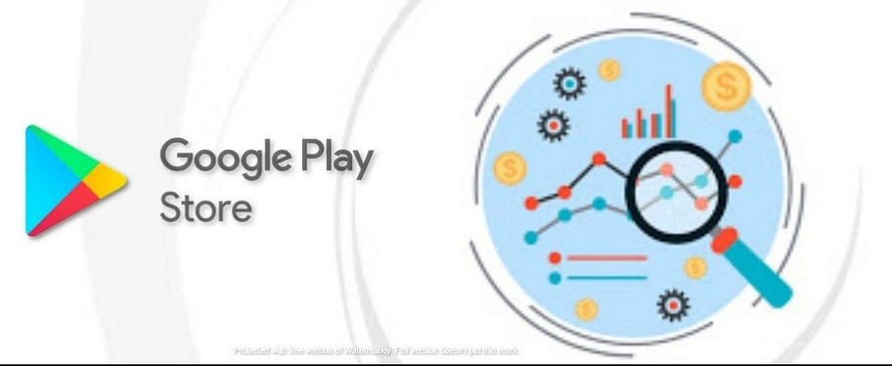
Project
Objective
The objective of this project is to clean, preprocess and Analyze Google Play Store app data using Python.
The project focuses on:
Data quality improvement
Missing-value handling
Duplicate removal
Data type conversion
Feature engineering
Exploratory Data Analysis
Visualization
Interactive dashboard development

Slide 3
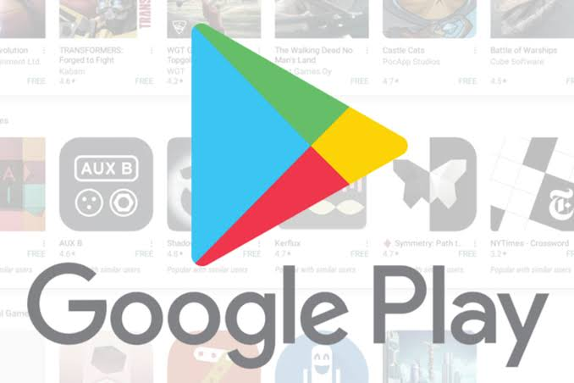
Google Play Store Dataset
The dataset contains information about Android applications available on the Google Play Store.
Important columns
App
Category
Rating
Reviews
Size
Installs
Type
Price
Content Rating
Genres
Last Updated
Current Version
Android Version
Source: Google Play Store dataset commonly distributed through Kaggle/GitHub.

Slide 4
Checked missing values
Identified duplicate records
Removed duplicate app records
Filled missing numerical ratings using the median
Filled missing categorical values using the mode
Removed unnecessary symbols from numeric fields
Converted Reviews to numeric
Converted Installs to numeric
Converted Price to numeric
Converted Size into MB
Converted Last Updated into datetime format
Data
Cleaning
Process

Slide 5
Data Transformation
Feature Engineering
1
New analytical features were created from the cleaned dataset.
Created features
Size_MB
2
Converted application size into a common MB unit.
Updated Year
3
Extracted the year from the Last Updated column.
Updated Month
4
Extracted the month from the Last Updated column.

Slide 6
Remaining missing values
Duplicate records
Invalid Ratings
Data Quality Validation
Negative Reviews
Negative Installs
Negative Prices
Incorrect data types
Incosistent text formatting

Slide 7
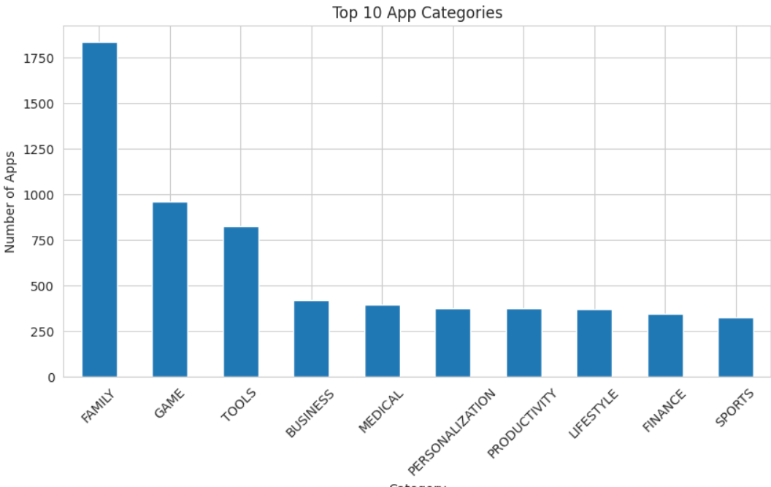
Category Analysis
App Category Distribution
Top 10 App Categories
Discuss:
Number of apps by category
Categories with higher representation
Distribution of applications across categories
Use the actual chart generated from your cleaned dataset.

Slide 8
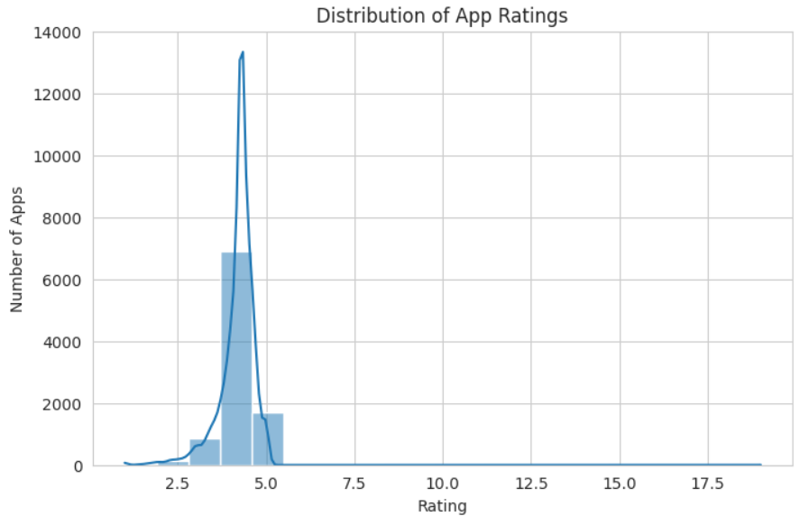
Rating Analysis
App Rating Distribution
Rating Distribution
Discuss:
Distribution of app ratings
Concentration of ratings
Presence of unusually low/high ratings
Overall rating pattern
Do not claim a specific average unless it comes from your actual output.

Slide 9
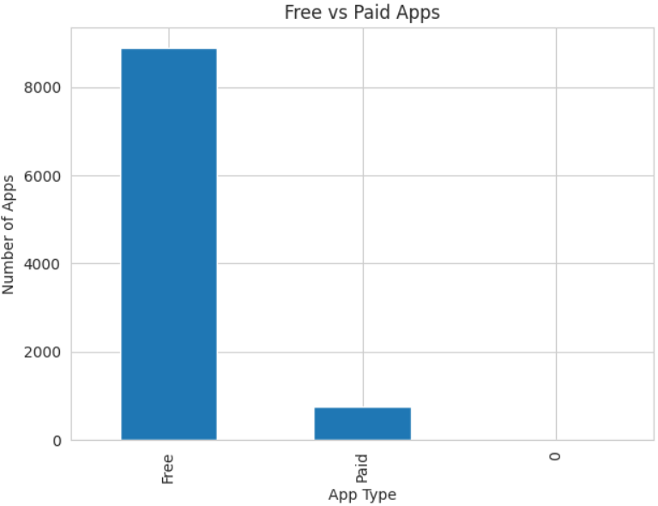
Free vs Paid Apps
Pricing Analysis
Free vs Paid Apps
Analyze:
Number of free applications
Number of paid applications
Proportion of free vs paid apps
Pricing distribution among paid applications

Slide 10
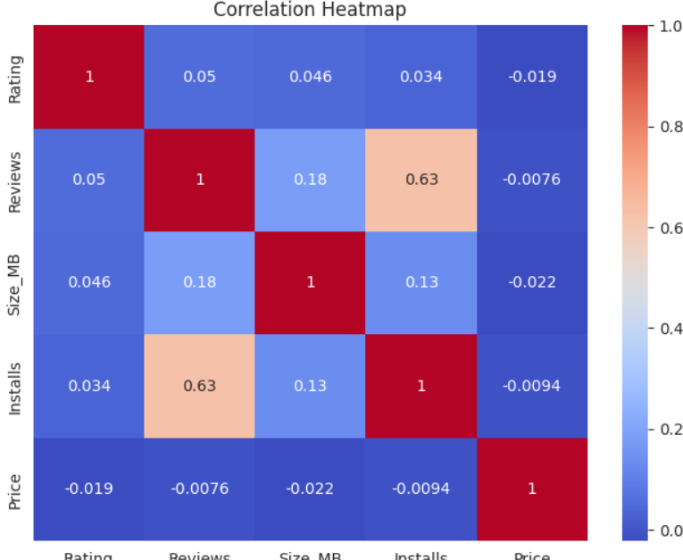
Install & Reviews
User Engagement Analysis
Charts:
Top Installed Apps
Reviews vs Rating
Analyze the relationship between:
Reviews → User engagement
Installs → App reach
Use your actual results rather than assuming that higher ratings automatically mean higher installs.

Slide 11
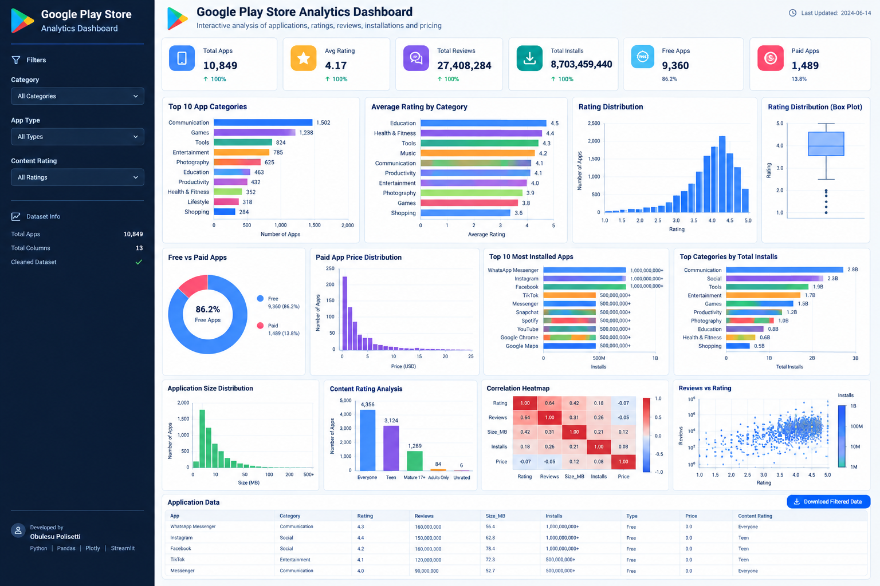
Dashboard
Interactive Python Dashboard
The dashboard provides:
KPI cards
Category filters
Rating distribution
Free vs Paid analysis
Installation analysis
Review analysis
App-size analysis
Interactive data table
Technology: Python + Streamlit + Plotly + Pandas

Slide 12
Conclusion
This project demonstrates a complete data analytics workflow starting from raw data and progressing through:
Data Collection → Data Cleaning → Transformation → Feature Engineering → EDA → Visualization → Dashboard
The project improved the usability of the Google Play Store dataset and created a foundation for further business-oriented analysis.
Future Scope
Predict app ratings
Analyze app success factors
Build recommendation systems
Perform statistical testing
Develop machine-learning models

Slide 13
THANK YOU
Using Python, Pandas & Data Visualization
Obulesu Polisetti

